Slide 1


WELCOME
C PROGRAMMING GROUP PROJECT PRESENTATION
Course no: EE1222
Group no: 02

Slide 2

Project Details
Hall Management System
Objectives :
To create smart hall management system.
To ensure digital security and access control.
To enhance automatic meal tracking .
HALL

Slide 3
This Project is
Submitted to
Submitted By
Anis Ahmed
Lecturer
Department of Electrical & Electronic Engineering Khulna university of engineering & Technology
Md. Sajjad Hossain
Lecturer
Department of Electrical & Electronic Engineering Khulna university of engineering & Technology
Md. Sadat Hossain
Roll: 2203001
Department of Electrical and Electronic Engineering
Khulna University of Engineering and Technology
Md. Junayad
Roll: 2203003
Department of Electrical and Electronic Engineering
Khulna University of Engineering and Technology
Rezoan Ahmed Riam
Roll: 2203004
Department of Electrical and Electronic Engineering
Khulna University of Engineering and Technology

Slide 4
About the project
The Hall Management System is a user-friendly software application designed to help students easily manage their personal details and essential services associated with their stay in university halls. It streamlines several important tasks, such as logging in securely, viewing personal information, managing meal preferences, and checking payment dues. In addition, the system provides features to help students change their passwords or reset them if forgotten, making the process efficient and hassle-free. The goal of this system is to make it easier for students to manage their day-to-day hall-related tasks in a secure and convenient way.

Slide 5
Overview of code
Allows students to :
Log in using a username and password.
View personal details such as name, date of birth, and blood group.
Toggle meal status to on or off the user’s meal plan.
Check payment dues for hall-related charges.
Change their password.

Slide 6
Overview of code
Features a password recovery system using a security question and answer.
Utilizes a structure to store student details.
Includes several functions to manage:
Login and logout.
Meal status changes.
Payment details.
Password changes and recovery.

Slide 7
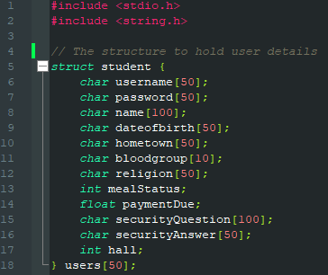
Structure definition
The core data of the program is managed using a structure that holds student details.
This structure contains fields like :
Personal Information : Name, username, password, etc.
Meal Status : Tracks whether the meal plan is active.
Payment Due : Stores the outstanding balance for hall dues.
Security Question : For password recovery purposes.

Slide 8
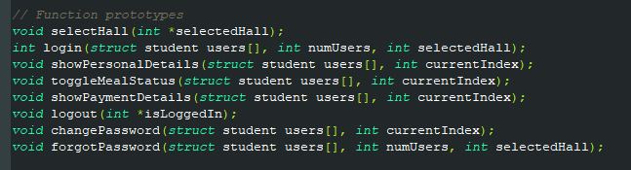
Key function and features
The program is made with several important functions:
selectHall() : Allows users to select a hall.
login() : Handles user login by comparing stored username and password.
showPersonalDetails() : Displays personal information, meal status, and payment details.

Slide 9
Key function and features
toggleMealStatus() : Lets the user turn their meal plan on or off.
showPaymentDetails() : Displays the total outstanding payments due.
changePassword() : Allows the user to change their password.
forgotPassword() : If the user forgets their password, they can # reset it by answering a security question.
logout() : Logs out the user.

Slide 10
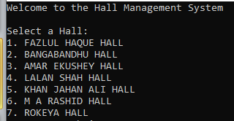
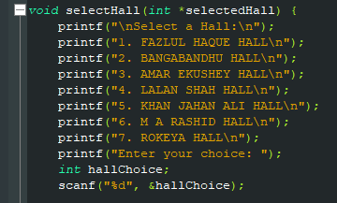
Main Menu Workflow
Upon launching the program, the user interacts with the following tasks :
Hall Selection : The user is asked to select a hall.
The user can select his /her hall by entering the co responding
number beside the hall name.
Respective Code

Slide 11
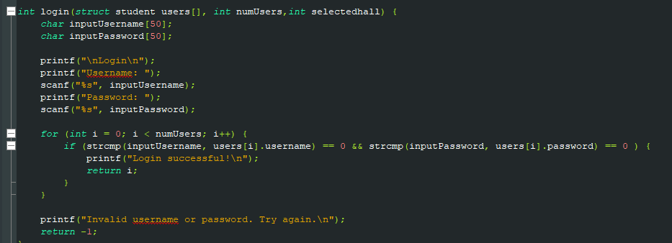
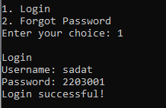
Main Menu Workflow
Login or Forgot Password : This options are presented if the user is not logged in. The user inputs a username and password to log in. If the password is forgotten, the user can reset it by answering a security question.
Respective Code
Output

Slide 12
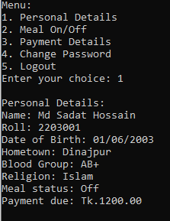

Main Menu Workflow
Once logged in, the following options are displayed : Personal Details, View name, date of birth, meal status etc.
Meal On/Off : Toggle the status of the meal plan.

Slide 13
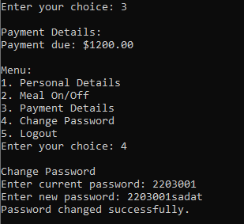
Main Menu Workflow
Payment Details : View how much payment is due.
Change Password : Change the login password.
Logout : Exit from the current session.

Slide 14
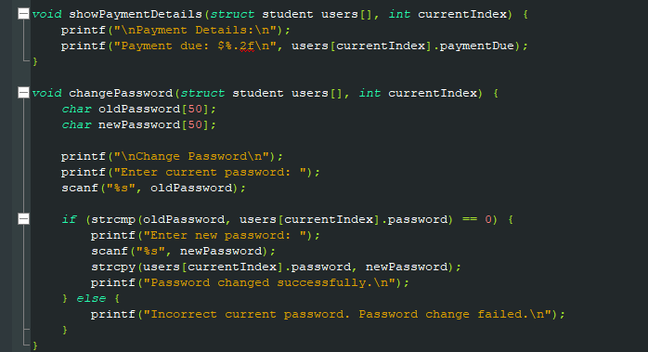
Respective code for payment details and change of password

Slide 15
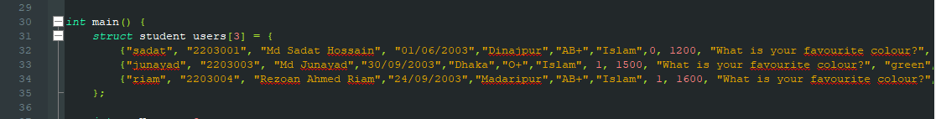
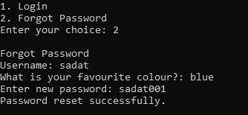
Code for containing all the details of user
Forget password option
Security QnA

Slide 16
Conclusion
The program starts by asking the user to select a hall.Users then log in using their username and password. If it is successful, the menu with the following options are displayed :
View personal details
Toggle meal status
View payment details
Change password.
Logout
There are options of upgrading this program such as we can also add seat allocation in student hall and automatic meal status tracking by collaborating the program with biometric scanning devices. Thus the program will be very helpfull for smart hall management system.

Slide 17
THE END

